Slide 1
Sorting Algorithms
Instructor: Javeria Naz

Slide 2
Sorting- Introduction
Sorting is used to arrange names and numbers in meaningful ways.
Let A be a list of n elements A1, A2, ....... An in memory.
Sorting of list A refers to the operation of rearranging the contents of A so that they are in increasing (or decreasing) order.

Slide 3
Cont . . . .
Sorting can be performed in many ways.
Over a time several methods (or algorithms) are being developed to sort data(s).
Bubble sort,
Selection sort,
Quick sort,
Merge sort,
Heap sort
Binary sort,
Shell sort
Radix sort are the few sorting techniques

Slide 4
Bubble Sort
Bubble sort is a sorting algorithm that compares two adjacent elements and swaps them until they are not in the intended order.
Just like the movement of air bubbles in the water that rise up to the surface, each element of the array move to the end in each iteration. Therefore, it is called a bubble sort.

Slide 5
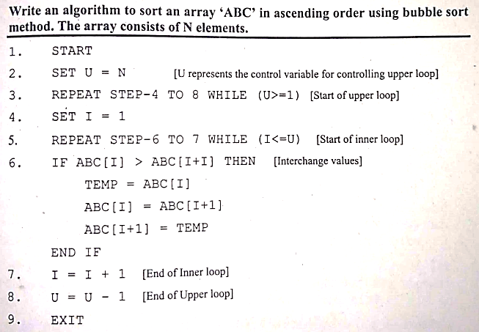
Algorithm

Slide 6
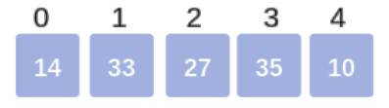
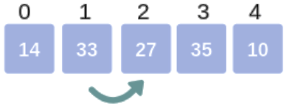
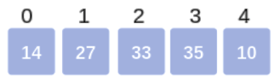
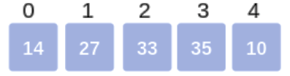
Cont.
Bubble Sort Example:
First Pass:
We proceed with the first and second element i.e., Arr[0] and Arr[1]. Check if 14 > 33 which is false. So, no swapping happens and the array remains the same.
We proceed with the second and third element i.e., Arr[1] and Arr[2]. Check if 33 > 27 which is true. So, we swap Arr[1] and Arr[2].
Thus the array becomes:
We proceed with the third and fourth element i.e., Arr[2] and Arr[3]. Check if 33 > 35 which is false. So, no swapping happens and the array remains the same.

Slide 7
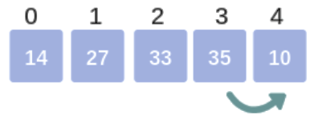
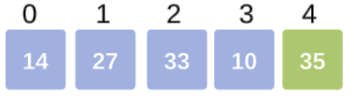
Cont.
We proceed with the fourth and fifth element i.e., Arr[3] and Arr[4]. Check if 35 > 10 which is true. So, we swap Arr[3] and Arr[4]
So, after swapping the array becomes:
Thus, marks the end of the first pass, where the Largest element reaches its final(last) position.

Slide 8
Insertion Sort
Insertion sort algorithm sorts a set of values by inserting values into an existing sorted file.
﻿The insertion sort works by inserting each item into its proper position in the list.
This sort method is relatively simple and easier to implement.
However, it is inefficient for larger lists.
In insertion sorting, the list of array is read from the beginning to the end. each iteration, one element is inserted into its correct position relative to the previously sorted elements of the list.
The array elements are not swapped or interchanged. These are shifted towards the right of the list to make room for the element to be inserted.

Slide 9
Working of insertion sort
Insertion sort splits an array into two sub-arrays.
The first sub-array is always sorted and gets larger as the sort continues.
The second sub-array gets smaller as the sort progresses.
When the sort first begins the first elements in the array is considered to sorted array.
With each iteration of the loop, the next value in the unsorted section is placed into its proper position in the sorted section.
This sorting procedure is efficient for smaller values

Slide 10
Example (ascending order)
Original Array | 76 | 3 | 94 | 55 | 21 | 1
Iteration 1 | 76 | 3 | 94 | 55 | 21 | 1
Iteration 2 S0: Swap | 3 | 76 | 94 | 55 | 21 | 1
Iteration 3 | 3 | 76 | 94 | 55 | 21 | 1
94<76 No leave | 3 | 76 | 94 | 55 | 21 | 1

Slide 11
Cont . . .
Iteration 4 S0:Swap | 3 | 76 | 55 | 94 | 21 | 1
55<76 True Swap | 3 | 55 | 76 | 94 | 21 | 1
55<3 No Leave | 3 | 55 | 76 | 94 | 21 | 1

Slide 12
Cont . . . .
Iteration 5 | 3 | 55 | 76 | 94 | 21 | 1
S0: True Swap | 3 | 55 | 76 | 21 | 94 | 1
21<76 True Swap | 3 | 55 | 21 | 76 | 94 | 1
21<55 True Swap | 3 | 21 | 55 | 76 | 94 | 1
21<3 No Leave | 3 | 21 | 55 | 76 | 94 | 1

Slide 13
Cont . . .
Iteration 6 | 3 | 21 | 55 | 76 | 94 | 1
S0: true Swap | 3 | 21 | 55 | 76 | 1 | 94
1<76 true Swap | 3 | 21 | 55 | 1 | 76 | 94
1<55 true Swap | 3 | 21 | 1 | 55 | 76 | 94
1<21 true Swap | 3 | 1 | 21 | 55 | 76 | 94
1<3 true Swap | 1 | 3 | 21 | 55 | 76 | 94
Sorted | 1 | 3 | 21 | 55 | 76 | 94

Slide 14
Cont . . .
Task :
Sort the following into descending order
Un Sorted Array | 7 | 5 | 2 | 4 | 3 | 9

Slide 15
Algorithm for Insertion Sort
for i = 1 to n-1
j =1
while j > 0 and A[ j ] < A[ j -1]
swap (A[ j ] , A[ j – 1 ])
j = j - 1

Slide 16
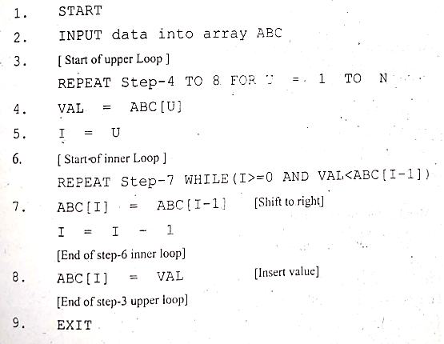
Algorithm for Insertion Sort

Slide 17
Merge Sort
Based on divide and conquer strategy
List is divided into two halves (Divide)
Each half is sorted independently (Conquer)
Two halves are merged into a sorted sequence.

Slide 18
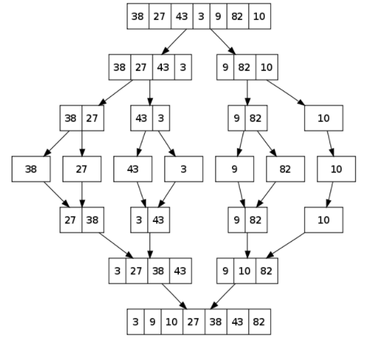

Slide 19
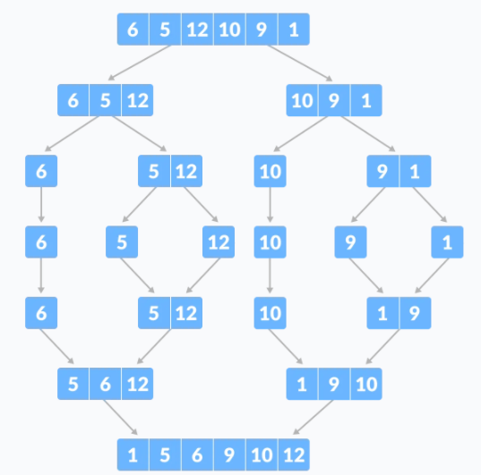

Slide 20
Merge sort
Mergesort (divide-and-conquer)
Divide array into two halves.
A
L
G
O
R
I
T
H
M
S
A
L
G
O
R
I
T
H
M
S
divide

Slide 21
Merge sort
Mergesort (divide-and-conquer)
Divide array into two halves.
Recursively sort each half.
A
L
G
O
R
I
T
H
M
S
A
L
G
O
R
I
T
H
M
S
divide
A
G
L
O
R
H
I
M
S
T
sort

Slide 22
Merge sort
Mergesort (divide-and-conquer)
Divide array into two halves.
Recursively sort each half.
Merge two halves to make sorted whole.
A
L
G
O
R
I
T
H
M
S
A
L
G
O
R
I
T
H
M
S
divide
A
G
L
O
R
H
I
M
S
T
sort
A
G
H
I
L
M
O
R
S
T
merge

Slide 23
Merging
Merge.
Keep track of smallest element in each sorted half.
Insert smallest of two elements into auxiliary array.
Repeat until done.
smallest
smallest
A
G
L
O
R
H
I
M
S
T
A
auxiliary array

Slide 24
Merging
Merge.
Keep track of smallest element in each sorted half.
Insert smallest of two elements into auxiliary array.
Repeat until done.
smallest
smallest
A
G
L
O
R
H
I
M
S
T
A
G
auxiliary array

Slide 25
Merging
Merge.
Keep track of smallest element in each sorted half.
Insert smallest of two elements into auxiliary array.
Repeat until done.
smallest
smallest
A
G
L
O
R
H
I
M
S
T
A
G
H
auxiliary array

Slide 26
Merging
Merge.
Keep track of smallest element in each sorted half.
Insert smallest of two elements into auxiliary array.
Repeat until done.
smallest
smallest
A
G
L
O
R
H
I
M
S
T
A
G
H
I
auxiliary array

Slide 27
Merging
Merge.
Keep track of smallest element in each sorted half.
Insert smallest of two elements into auxiliary array.
Repeat until done.
smallest
smallest
A
G
L
O
R
H
I
M
S
T
A
G
H
I
L
auxiliary array

Slide 28
Merging
Merge.
Keep track of smallest element in each sorted half.
Insert smallest of two elements into auxiliary array.
Repeat until done.
smallest
smallest
A
G
L
O
R
H
I
M
S
T
A
G
H
I
L
M
auxiliary array

Slide 29
Merging
Merge.
Keep track of smallest element in each sorted half.
Insert smallest of two elements into auxiliary array.
Repeat until done.
smallest
smallest
A
G
L
O
R
H
I
M
S
T
A
G
H
I
L
M
O
auxiliary array

Slide 30
Merging
Merge.
Keep track of smallest element in each sorted half.
Insert smallest of two elements into auxiliary array.
Repeat until done.
smallest
smallest
A
G
L
O
R
H
I
M
S
T
A
G
H
I
L
M
O
R
auxiliary array

Slide 31
Merging
Merge.
Keep track of smallest element in each sorted half.
Insert smallest of two elements into auxiliary array.
Repeat until done.
first half exhausted
smallest
A
G
L
O
R
H
I
M
S
T
A
G
H
I
L
M
O
R
S
auxiliary array

Slide 32
Merging
Merge.
Keep track of smallest element in each sorted half.
Insert smallest of two elements into auxiliary array.
Repeat until done.
first half exhausted
smallest
A
G
L
O
R
H
I
M
S
T
A
G
H
I
L
M
O
R
S
T
auxiliary array

Slide 33
Algorithm for Merge Sort
MERGE-SORT(A, p, r)
if p < r Check for base case
then q ← ⎣(p + r)/2⎦ MERGE-SORT(A, p, q) MERGE-SORT(A, q + 1, r) MERGE(A, p, q, r)
MERGE(A, p, q, r)
Compute n₁ and n₂
Copy the first n₁ elements into L[1 . . n₁ + 1] and the next n₂ elements into R[1 . . n₂ + 1]
L[n₁ + 1] ← ∞; R[n₂ + 1] ← ∞
i ← 1; j ← 1
for k ← p to r
do if L[ i ] ≤ R[ j ]
then A[k] ← L[ i ]
i ←i + 1
else A[k] ← R[ j ]
j ← j + 1
p
q
r
1
2
3
4
5
6
7
8
5
2
4
7
1
3
2
6
p
q
r
p
q
1
2
3
4
5
6
7
8
L
2
4
5
7
∞
2
4
5
7
1
2
3
6
q + 1
r
R
1
2
3
6
∞
n₁
n₂

